Slide 1
Week 4
Introduction to Queries and Relational Languages

Slide 2
Student Objectives
Upon completion of this video, you should be able to:
Given some tables, give examples of queries that you would ask of the tables.
Distinguish between procedural languages and non procedural languages
Determine, given operators for a data type, if the operators enforce closure.
List the 5 basic operators for relational algebra and determine if each of those operations works on one table (unary) or two tables (binary).

Slide 3
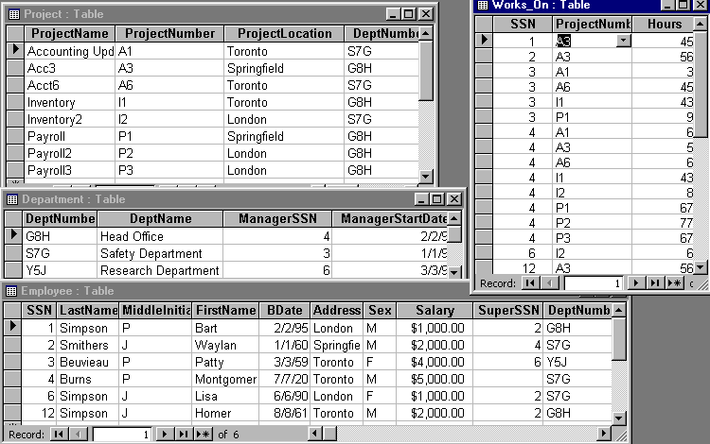
Consider…
Fred needs to know how many people worked more than 40 hours on a project
Sue needs to know who works in the Safety Department
Homer wants to know how many supervising employees make over 2000 dollars

Slide 4
Relational Languages
Once we have our relational model, we need to manipulate the data within the model, we use a relational language
Some relational languages are Procedural, they tell us how to get the data (e.g. Relational Algebra)
Some relational languages are Non-Procedural, they tell us what data is needed (e.g. Relational Calculus)
Formally, Relational Algebra is equivalent to Relational Calculus, i.e. every expression in the algebra can be written also in the calculus and vise versa

Slide 5
A language that can produce any relation that can be derived using relational calculus is relationally complete.
Most relational query languages are relationally complete and more (i.e. they have additional power to do calculations, ordering, etc.)
Relational algebra is a theoretical language with operations that perform on one or more relations and in turn produce relations based on the operations, thus both the input (operands) and output (results) are relations, i.e. a closed language, i.e. integer - integer produces an integer and a relation - relation produces a relation

Slide 6
Example of Closure with Relations
Pretend that the symbol represents an operation for the operand tables (i.e. relations) (just like + represents an operation with the operands integers)
Then would be a closed operation if and only if:
In this case is a binary operation (2 operands).
Could be unary operation like this:
=
34 | Pig | Red
445 | Horse | Red
34 | Cat | Blue
33 | X | Mar | 2018 | London | 22.2
44 | Y | Jun | 1964 | Toronto | 45.1
55 | X | Feb | 1982 | Windsor | 23.8
22 | B | Jan | 1977 | Arva | 0.1
A Table
=
A Table
34 | Pig | Red
445 | Horse | Red
34 | Cat | Blue

Slide 7
QUESTION: Do the operations -,+,/,* produce a closed language on integers? YES or NO? WHY?
NO! Because of / → Division e.g. 9 / 2
Relational algebra is a set language, in which all tuples are manipulated in one statement, thus we don't use looping
Because relations are produced, we can use the results in further operations, thus nesting our results, this is called closure; relations are closed under relational algebra

Slide 8
QUESTION: What are unary operations with integers that insure closure?
ANSWER: Power, Absolute Value…eg. 77² or abs(77)
QUESTION: What are unary operations with integers that do not allow for closure?
ANSWER: Square Root…eg. 77
QUESTION: What are some unary operations when working with bits?
ANSWER: FLIP…eg FLIP (1011) = 0100

Slide 9
Basic operations can be used to build other more complicated operations
Eg. For integers, in order to create exponents, we could use the basic operation of multiplication:
3 ⁴ is the same as 3 * 3 * 3 * 3
so * is a basic operation in arithmetic.

Slide 10
5 Basic Operations in Relational Algebra
Selection: Unary (works on 1 Relation (TABLE) only), returns only the tuples from a relation that satisfy the specified condition. (i.e. returns a row subset), written as:
σ _{condition} (R)
Projection: Unary (works on 1 Relation only), returns only the requested attributes (with no duplicates) (returns a column subset), written as:
π _{attribute1, attribute2} (R)

Slide 11
Cartesian Product: Binary (requires 2 Relations), returns a relation that is the concatenation of every tuple of relation R with every tuple of relation S, Symbol: S X R
Union: Binary (requires 2 Relations), union of relations R and S with I and J tuples, respectively, is the concatenation of them into one relation with a maximum of I+J tuples, duplicate tuples being eliminated, R and S must be union compatible (i.e. R and S must have the same columns or attribute domains). Symbol: R U S
Set Difference: (requires 2 Relations), R-S = a relation consisting of the tuples that are in relation R but not in S, R and S must be union compatible. S - R

